Slide 1


Slide 2
Mehak Rafiq & Rakhshanda Ata
Class: BS-II Zoology (M2)
Topic: LIVER TRANSPLANT
Invigilator: Miss Mary Mehwish

Slide 3
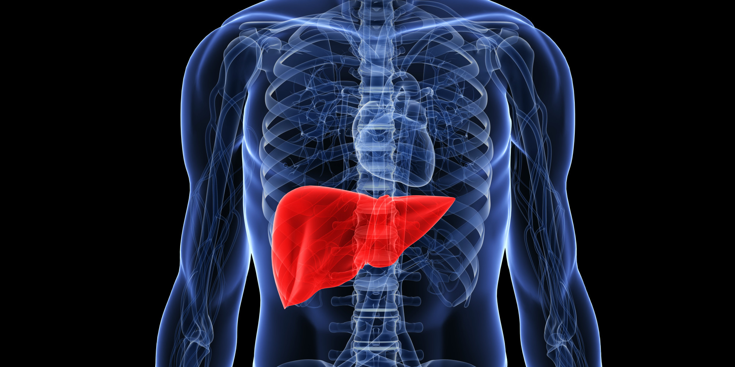
LIVER TRANSPLANT

Slide 4
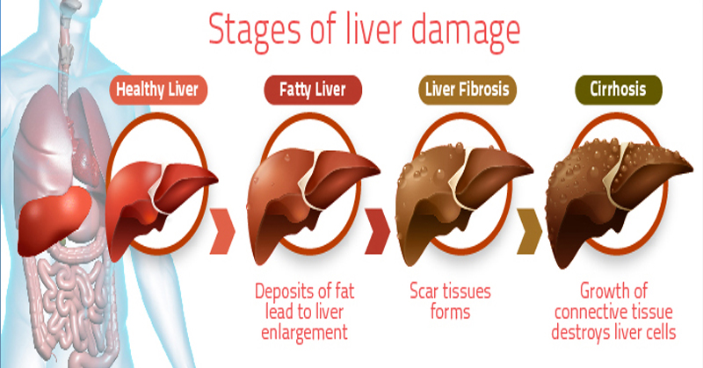
Indications

Slide 5
Who needs a liver transplant
A doctor may recommend a liver transplant for a person with end-stage liver disease. A person with this condition will die without a transplant.
A liver transplant may also be suggested if other treatments for liver disease are not enough to keep person alive.
Cirrhosis is also the most common reason why adults need liver transplant. causes of cirrhosis include:
ALOCOHOL ABUSE
CHRONIC HEPATITIS B & C
NON ALCOHOLIC FATTY LIVER DISEASE
AUTOIMMUNE HEPATITIS
BILIARY ATRESIA, a liver disease in newborns
METABOLIC DISORDERS

Slide 6
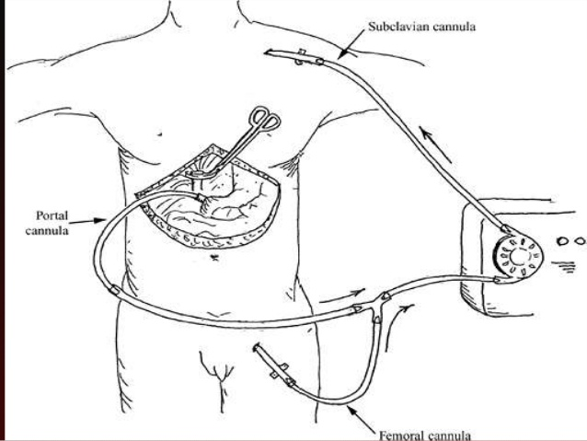
TECHNIQUE
(PIGGYBACK)

Slide 7
Living donor liver transplantation (ldlt) and its requirements
Being in good health.
Having a blood type that matches with the recipients.
Having a charitable desire of donation.
Being between 18 – 60 years old.
Being of similar or bigger size than the recipient.
Sometimes CT scans or MRIs are done to image the liver.

Slide 8
complications
All potential donors should know there is a 0.5 – 1% chance of death.
Other risks of donating a liver include:
BLEEDING
DAMAGE TO THE BILE DUCTS
HIGH BLOOD SUGAR
INFECTION
PAINFUL INCISION
POSSIBILITY OF BLOOD CLOTS
PROLONGED RECOVERY
The vast majority of donor enjoy complete and full recovery within 2- 3 months.

Slide 9
RESULTS
It is quite good ,but those with certain illness may differ.
There is no exact model to predict survival rates; those with transplant have a 58% chance of surviving 15 years .
Failure of the new liver occurs in 10% to 15% of all cases. These percentages are contributed to by many complications.
Early graft failure is probably due to preexisting disease of the donated organ.
Others include technical flaws during surgery such as revascularization that may lead to a non-functioning graft.
It may be possible to remove up to 70% of the liver from a healthy living donor without harm in most cases.

Slide 10


